Slide 1

Searching Double J/Psi
Cynthia Hadjidakis
in Pb-Pb collision at $\sqrt{SAA}$=5TeV
Advisor: Cynthia Hadjidakis
Student: YEH, Yu-Chia

Slide 2
Outline
Introduction
Objective
Event selection
Inclusive J/Psi (practice)
Main work
Selection of events with more than four muons
Signal treatment
Conclusion and future work

Slide 3
Introduction
Notes:
The picture of collision

Slide 4
Object
Find the Double J/Psi produced after the collision of Pb-Pb.
Notes:
Jpsi decay, Pb-Pb possible way of collision

Slide 5
Run, Event selection and tracks cuts
2015/LHC15o/muon_calo_pass1/
MUL7-B-NOPF-MUFAST
centrality 0%~90%
MuEta, MuThetaAbs and MuMatchLpt
Select rapidity on dimuons, 2.5 < y < 4
Notes:
Graph of eta theta pt

Slide 6
Inclusive J/Psi
Fit
2 fit ranges: 2.2 to 4.5 and 2.4 to 4.7 (GeV)
2 fit background (Polynomial and Variable-width Gaussian)
1 fit signal (Extended Crystal Ball)
3 fit tails for signal (Monte-Carlo: GEANT3 and GEANT4, experimental: p-p)
In total there are 12 method of fits.
And because of there are two simulation tails are used, the experimental data is weighted by 2.
Notes:
Result of inclusive J/Psi

Slide 7
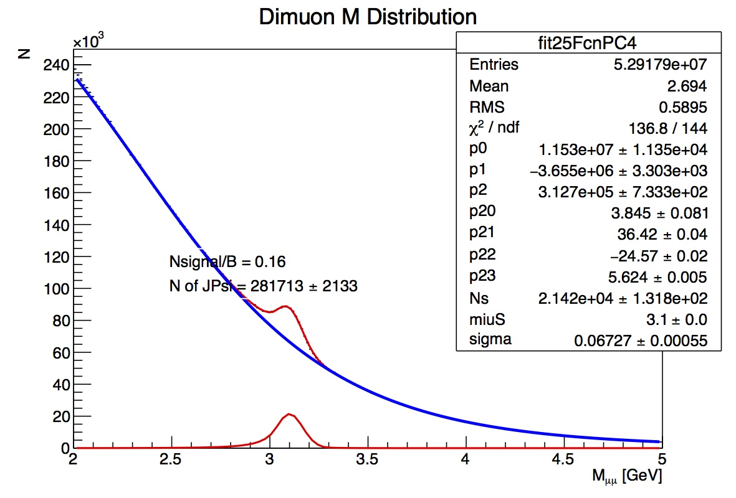

Slide 8
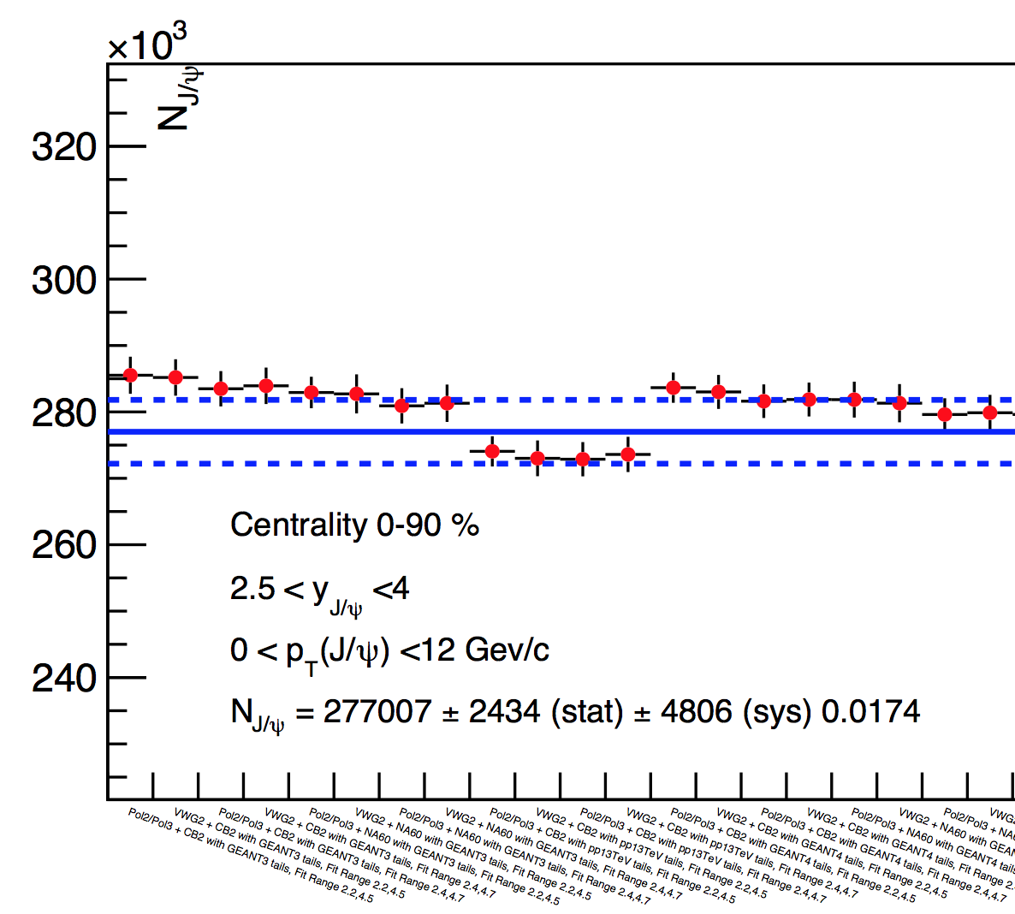
Add graph of the inclusive Jpsi paper

Slide 9
Notes:
Explain the graph and compare to the paper

Slide 10
Main work

Slide 11
Selection of dimuon pairs
Events with more than four muons
4 Muons

Slide 12
1
2
3
4
Muon(-)
Muon(+)
Dimuon
1
3
2
4
1
4
2
3

Slide 13
Dimuon
Dimoun
Higher Pt as Second pair

Slide 14
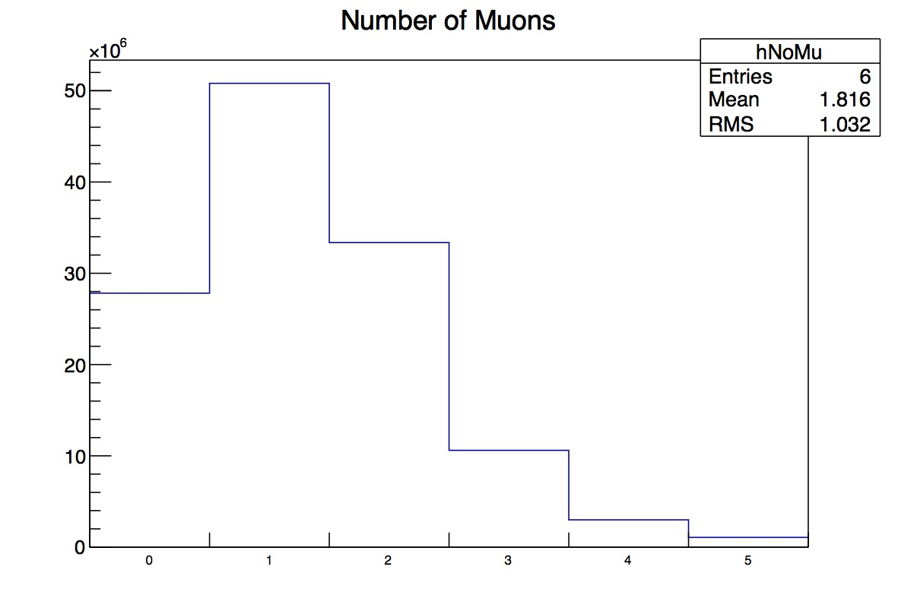
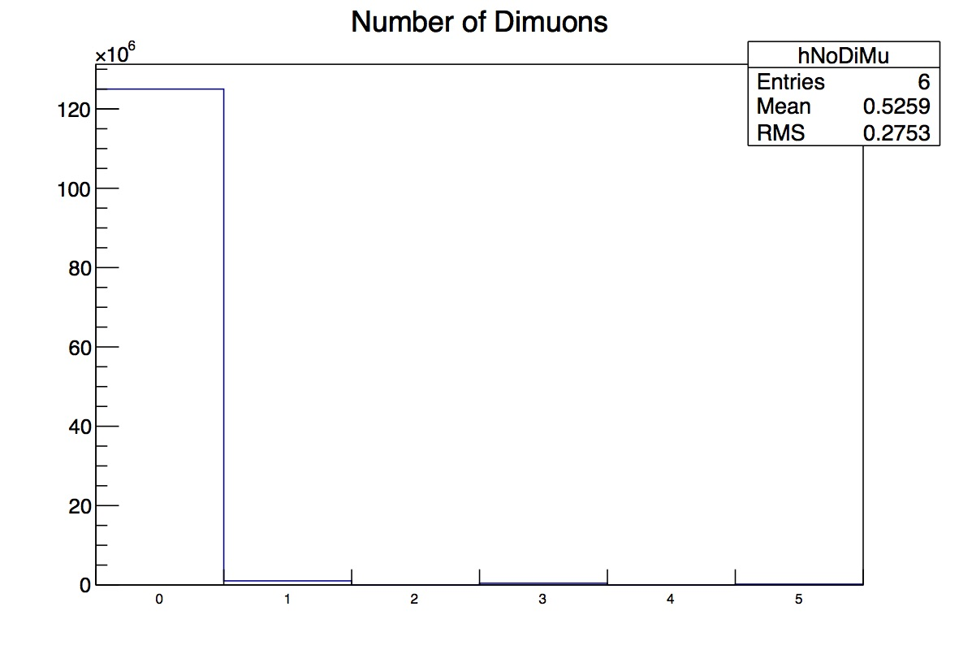
Multiplicity of muons and dimuons

Slide 15
Signal treating
Re-bin
Projection

Slide 16
Cross check

Slide 17
Searching for Double J/Psi
Fit
2 fit ranges: 2.2 to 4.5 and 2.4 to 4.7 (GeV)
3 fit background (Polynomial, Variable-width Gaussian and Exponential functions)
1 fit signal (Extended Crystal Ball)
3 fit tails for signal (Monte-Carlo: GEANT3 and GEANT4, experimental: p-p)
In total there are 18 method of fits.
And because of there are two simulation tails are used, the experimental data is weighted by 2.

Slide 18
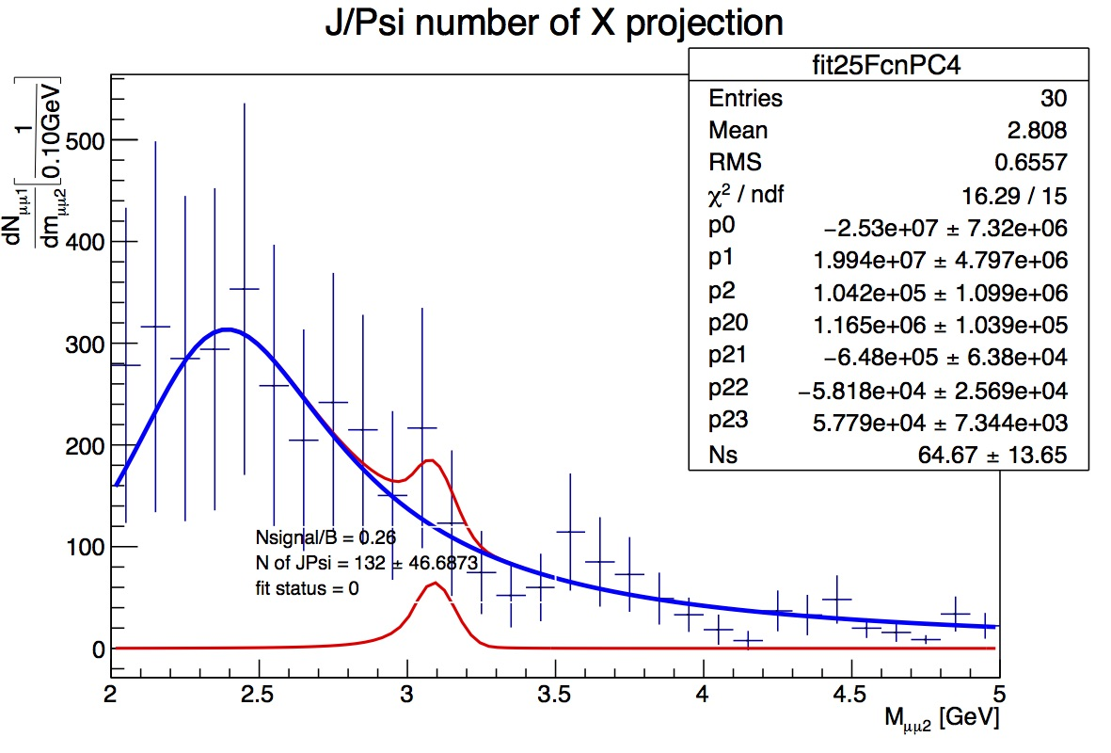

Slide 20
Conclusion and future work
Acquire the upper limit of double J/Psi.
Run Monte-Carlo to acquire Acceptance and Efficiency.

